Slide 1
Hyperion Project: Regions of interest
In the following slides are links to digital pathology scans and then the matched panoramas that we got through from Newcastle, annotated with regions of interest for the imaging mass cytometry work
The H&E picture shows where we extracted RNA from for each tumour sample – circled in black
With links to digital scans for the H&E and also CD68, CD45, Ki67 and HiF1A
I have highlighted WITHIN the black circled regions some areas of interest on each H&E slide.
The panorama then has 3+ red squares which is where the Hyperion will complete the ablation. Each square has a unique label. For each square I need estimates of % of
Cells with hypoxia (Hif1a)
Cells that are proliferating (Ki67)
Immune cells (CD45 and CD68)

Slide 2
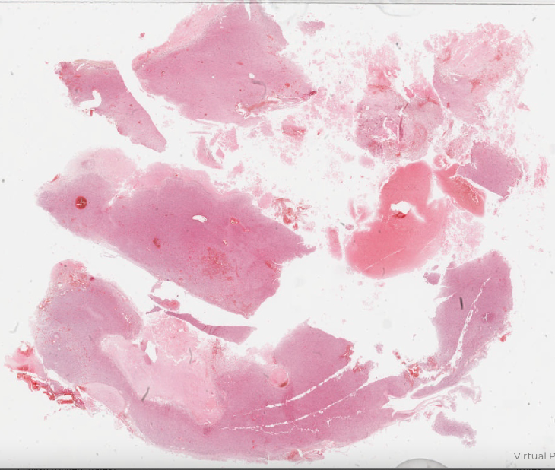
Cells with hypoxia (Hif1a)
Cells that are proliferating (Ki67)
Immune cells (CD45 and CD68)
64 Prim
H&E https://www.virtualpathology.leeds.ac.uk/slides/browser/view.php?path=%2FResearch_5/LIMM/GliomaGenomics/SP/2021_10_29%2F501048.svs
CD68 https://www.virtualpathology.leeds.ac.uk/slides/browser/view.php?path=%2FResearch_5/LIMM/GliomaGenomics/SP/2021_12_08%2F507209.svs
CD45 https://www.virtualpathology.leeds.ac.uk/slides/browser/view.php?path=%2FResearch_5/LIMM/GliomaGenomics/SP/2021_12_08%2F507217.svs
Ki67 https://www.virtualpathology.leeds.ac.uk/slides/browser/view.php?path=%2FResearch_5/LIMM/GliomaGenomics/SP/2021_12_08%2F507231.svs
HiF1A https://www.virtualpathology.leeds.ac.uk/slides/browser/view.php?path=%2FResearch_5/LIMM/GliomaGenomics/SP/2021_12_08%2F507239.svs

Slide 3
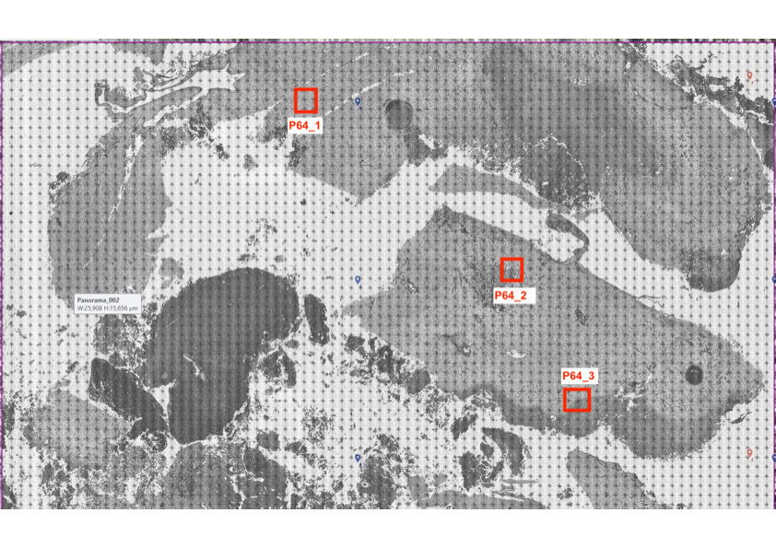

Slide 4
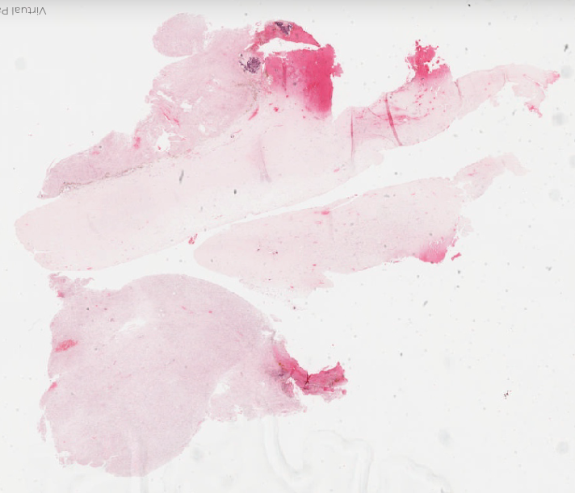
H&E https://www.virtualpathology.leeds.ac.uk/slides/browser/view.php?path=%2FResearch_5/LIMM/GliomaGenomics/SP/2021_10_29%2F501047.svs
CD68 https://www.virtualpathology.leeds.ac.uk/slides/browser/view.php?path=%2FResearch_5/LIMM/GliomaGenomics/SP/2021_12_08%2F507210.svs
CD45 https://www.virtualpathology.leeds.ac.uk/slides/browser/view.php?path=%2FResearch_5/LIMM/GliomaGenomics/SP/2021_12_08%2F507218.svs
Ki67 https://www.virtualpathology.leeds.ac.uk/slides/browser/view.php?path=%2FResearch_5/LIMM/GliomaGenomics/SP/2021_12_08%2F507229.svs
HiF1A https://www.virtualpathology.leeds.ac.uk/slides/browser/view.php?path=%2FResearch_5/LIMM/GliomaGenomics/SP/2021_12_08%2F507240.svs
64Rec002
64Rec003
Cells with hypoxia (Hif1a)
Cells that are proliferating (Ki67)
Immune cells (CD45 and CD68)
64Rec001

Slide 5
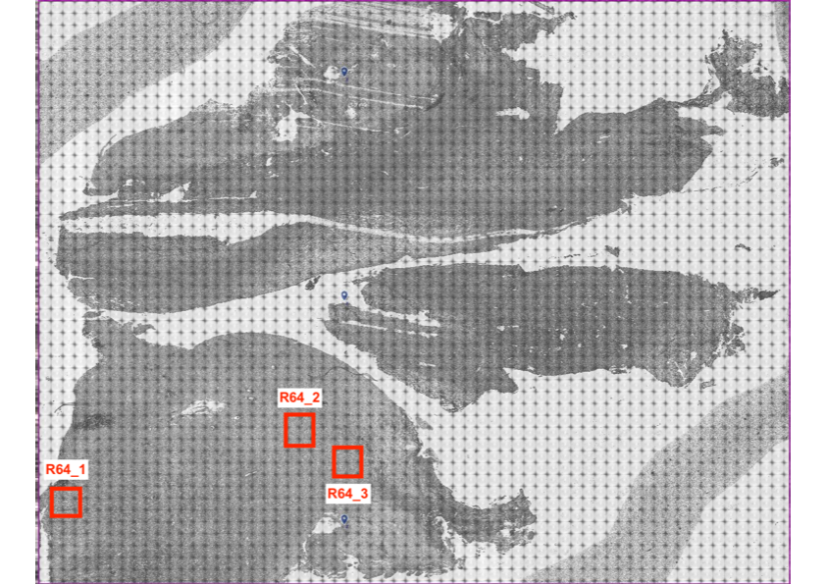

Slide 6
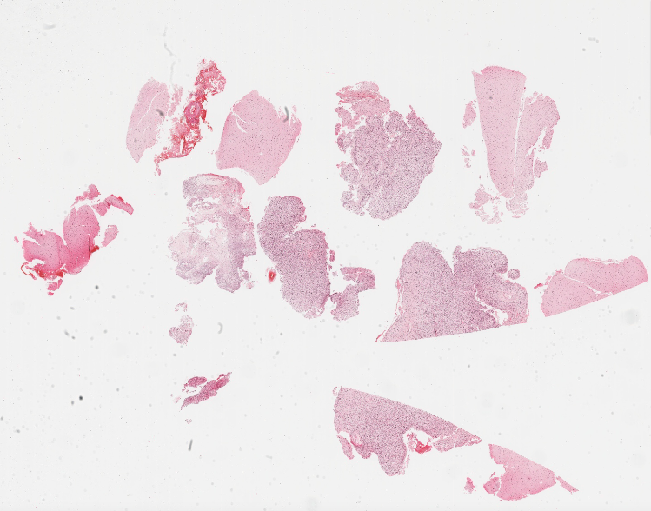
H&E https://www.virtualpathology.leeds.ac.uk/slides/browser/view.php?path=%2FResearch_5/LIMM/GliomaGenomics/SP/2021_10_29%2F501046.svs
CD68 https://www.virtualpathology.leeds.ac.uk/slides/browser/view.php?path=%2FResearch_5/LIMM/GliomaGenomics/SP/2021_12_08%2F507212.svs
CD45 https://www.virtualpathology.leeds.ac.uk/slides/browser/view.php?path=%2FResearch_5/LIMM/GliomaGenomics/SP/2021_12_08%2F507219.svs
Ki67 https://www.virtualpathology.leeds.ac.uk/slides/browser/view.php?path=%2FResearch_5/LIMM/GliomaGenomics/SP/2021_12_08%2F507245.svs
HiF1A https://www.virtualpathology.leeds.ac.uk/slides/browser/view.php?path=%2FResearch_5/LIMM/GliomaGenomics/SP/2021_12_08%2F507241.svs
67Prim003
67Prim004
67 Prim
Cells with hypoxia (Hif1a)
Cells that are proliferating (Ki67)
Immune cells (CD45 and CD68)

Slide 7
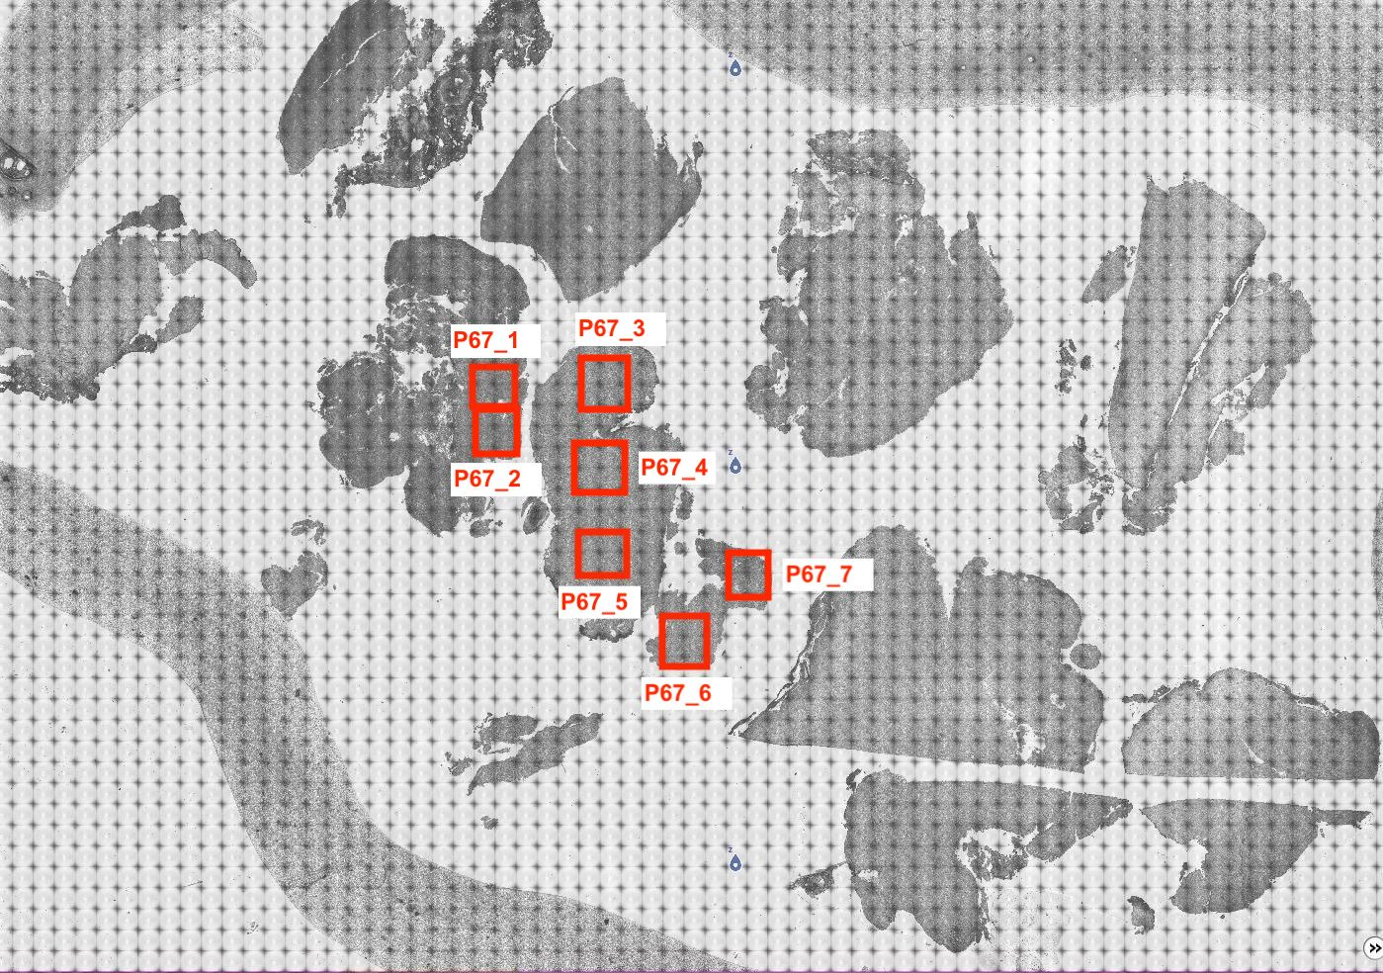

Slide 8
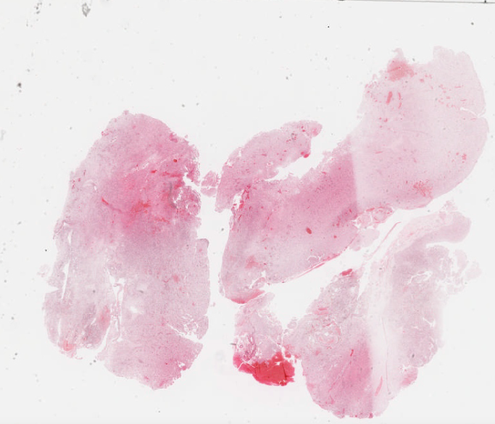
67Rec003
67Rec001
67Rec002
Cells with hypoxia (Hif1a)
Cells that are proliferating (Ki67)
Immune cells (CD45 and CD68)
67 Rec
H&E https://www.virtualpathology.leeds.ac.uk/slides/browser/view.php?path=%2FResearch_5/LIMM/GliomaGenomics/SP/2021_10_29%2F501051.svs
CD68 https://www.virtualpathology.leeds.ac.uk/slides/browser/view.php?path=%2FResearch_5/LIMM/GliomaGenomics/SP/2021_12_08%2F507213.svs
CD45 https://www.virtualpathology.leeds.ac.uk/slides/browser/view.php?path=%2FResearch_5/LIMM/GliomaGenomics/SP/2021_12_08%2F507221.svs
Ki67 https://www.virtualpathology.leeds.ac.uk/slides/browser/view.php?path=%2FResearch_5/LIMM/GliomaGenomics/SP/2021_12_08%2F507228.svs
HiF1A https://www.virtualpathology.leeds.ac.uk/slides/browser/view.php?path=%2FResearch_5/LIMM/GliomaGenomics/SP/2021_12_08%2F507242.svs

Slide 9
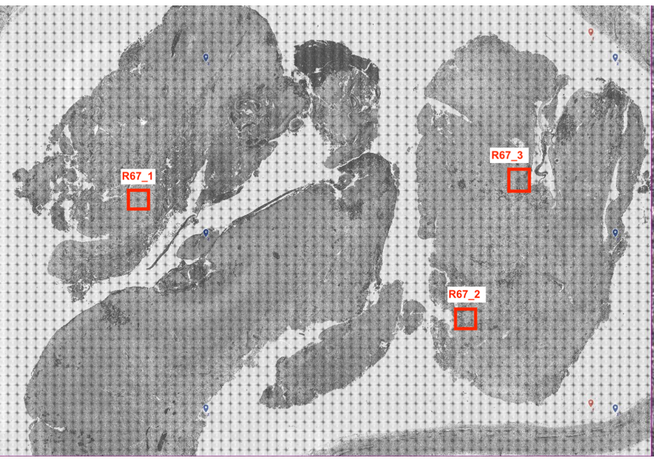

Slide 10
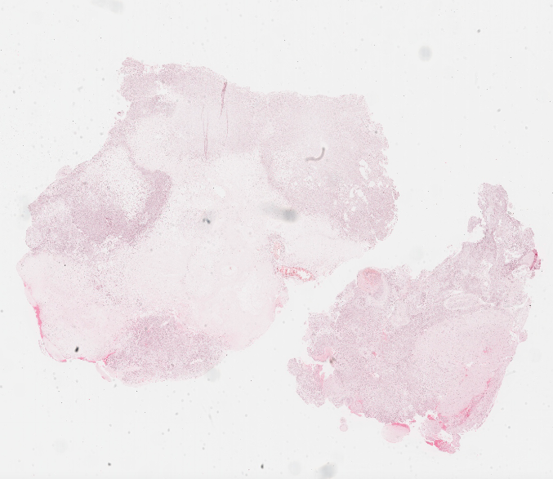
71Prim001
71Prim002
71Prim003
Cells with hypoxia (Hif1a)
Cells that are proliferating (Ki67)
Immune cells (CD45 and CD68)
71Prim
H&E https://www.virtualpathology.leeds.ac.uk/slides/browser/view.php?path=%2FResearch_5/LIMM/GliomaGenomics/SP/2021_10_29%2F501056.svs
CD68 https://www.virtualpathology.leeds.ac.uk/slides/browser/view.php?path=%2FResearch_5/LIMM/GliomaGenomics/SP/2021_12_08%2F507214.svs
CD45 https://www.virtualpathology.leeds.ac.uk/slides/browser/view.php?path=%2FResearch_5/LIMM/GliomaGenomics/SP/2021_12_08%2F507222.svs
Ki67 https://www.virtualpathology.leeds.ac.uk/slides/browser/view.php?path=%2FResearch_5/LIMM/GliomaGenomics/SP/2021_12_08%2F507227.svs
HiF1A https://www.virtualpathology.leeds.ac.uk/slides/browser/view.php?path=%2FResearch_5/LIMM/GliomaGenomics/SP/2021_12_08%2F507243.svs

Slide 11
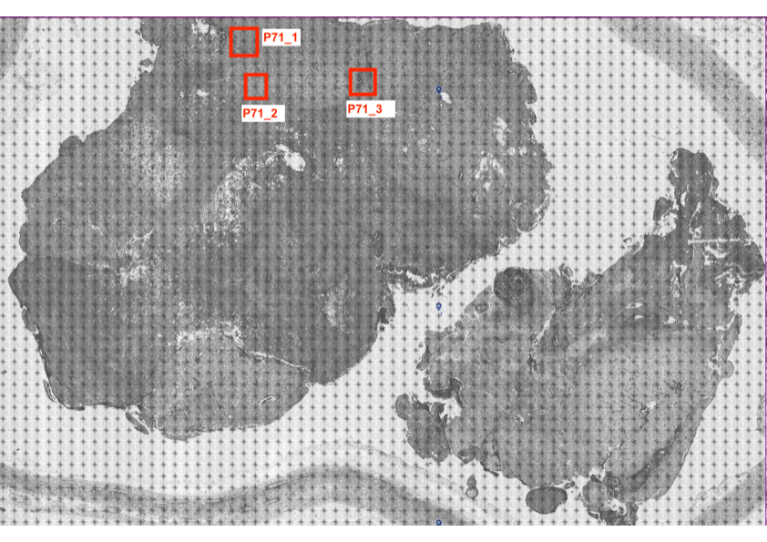

Slide 12
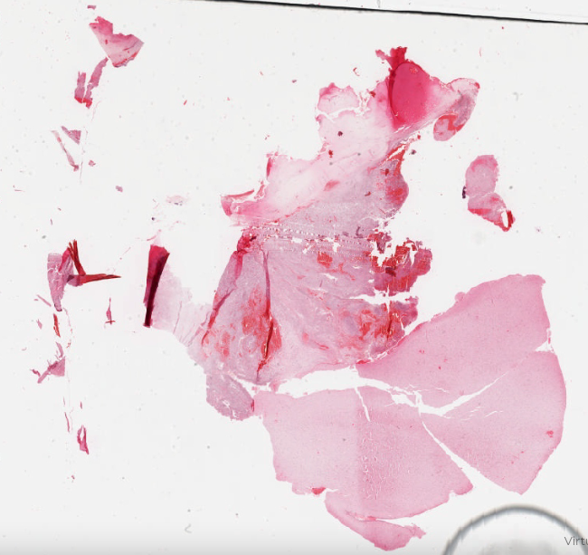
H&E https://www.virtualpathology.leeds.ac.uk/slides/browser/view.php?path=%2FResearch_5/LIMM/GliomaGenomics/SP/2021_10_29%2F501052.svs
CD68 https://www.virtualpathology.leeds.ac.uk/slides/browser/view.php?path=%2FResearch_5/LIMM/GliomaGenomics/SP/2021_12_08%2F507215.svs
CD45 https://www.virtualpathology.leeds.ac.uk/slides/browser/view.php?path=%2FResearch_5/LIMM/GliomaGenomics/SP/2021_12_08%2F507223.svs
Ki67 https://www.virtualpathology.leeds.ac.uk/slides/browser/view.php?path=%2FResearch_5/LIMM/GliomaGenomics/SP/2021_12_08%2F507206.svs
HiF1A https://www.virtualpathology.leeds.ac.uk/slides/browser/view.php?path=%2FResearch_5/LIMM/GliomaGenomics/SP/2021_12_08%2F507244.svs
71Rec001
71Rec002
71Rec003
Cells with hypoxia (Hif1a)
Cells that are proliferating (Ki67)
Immune cells (CD45 and CD68)

Slide 13
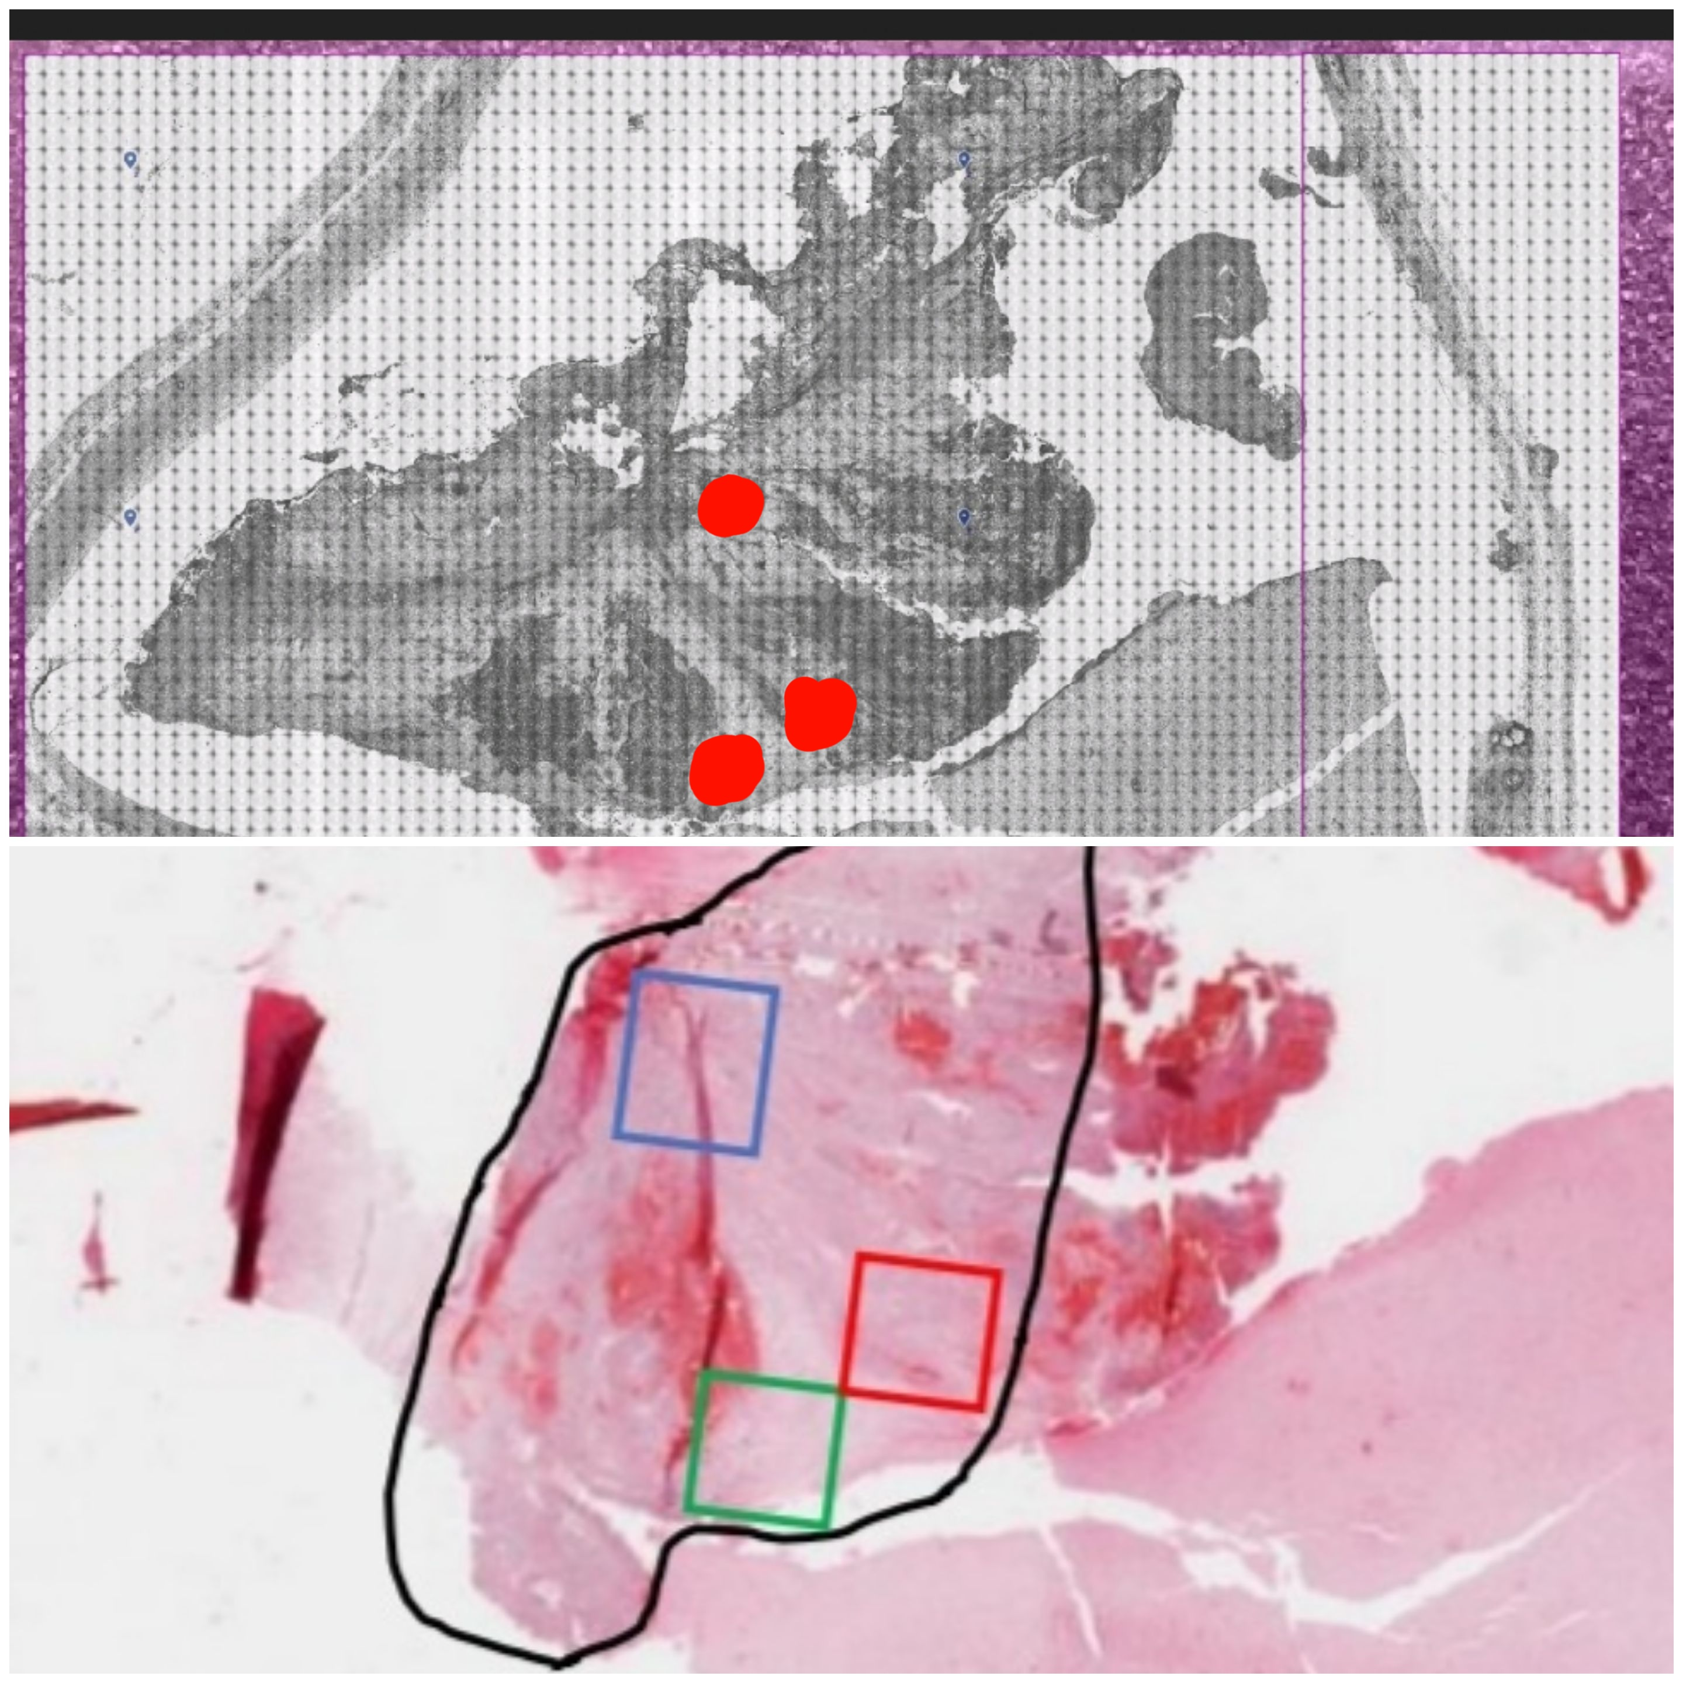
71 Rec

Slide 14
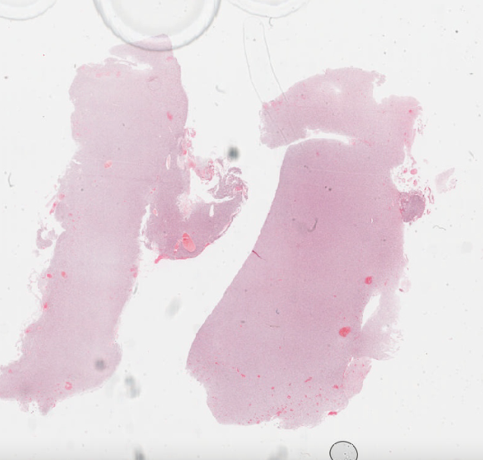
H&E https://www.virtualpathology.leeds.ac.uk/slides/browser/view.php?path=%2FResearch_5/LIMM/GliomaGenomics/SP/2021_10_29%2F501054.svs
CD68 https://www.virtualpathology.leeds.ac.uk/slides/browser/view.php?path=%2FResearch_5/LIMM/GliomaGenomics/SP/2021_12_08%2F507195.svs
CD45 https://www.virtualpathology.leeds.ac.uk/slides/browser/view.php?path=%2FResearch_5/LIMM/GliomaGenomics/SP/2021_12_08%2F507224.svs
Ki67 https://www.virtualpathology.leeds.ac.uk/slides/browser/view.php?path=%2FResearch_5/LIMM/GliomaGenomics/SP/2021_12_08%2F507205.svs
HiF1A https://www.virtualpathology.leeds.ac.uk/slides/browser/view.php?path=%2FResearch_5/LIMM/GliomaGenomics/SP/2021_12_08%2F507237.svs
82Prim001
82Prim002
Cells with hypoxia (Hif1a)
Cells that are proliferating (Ki67)
Immune cells (CD45 and CD68)
82Prim003

Slide 15
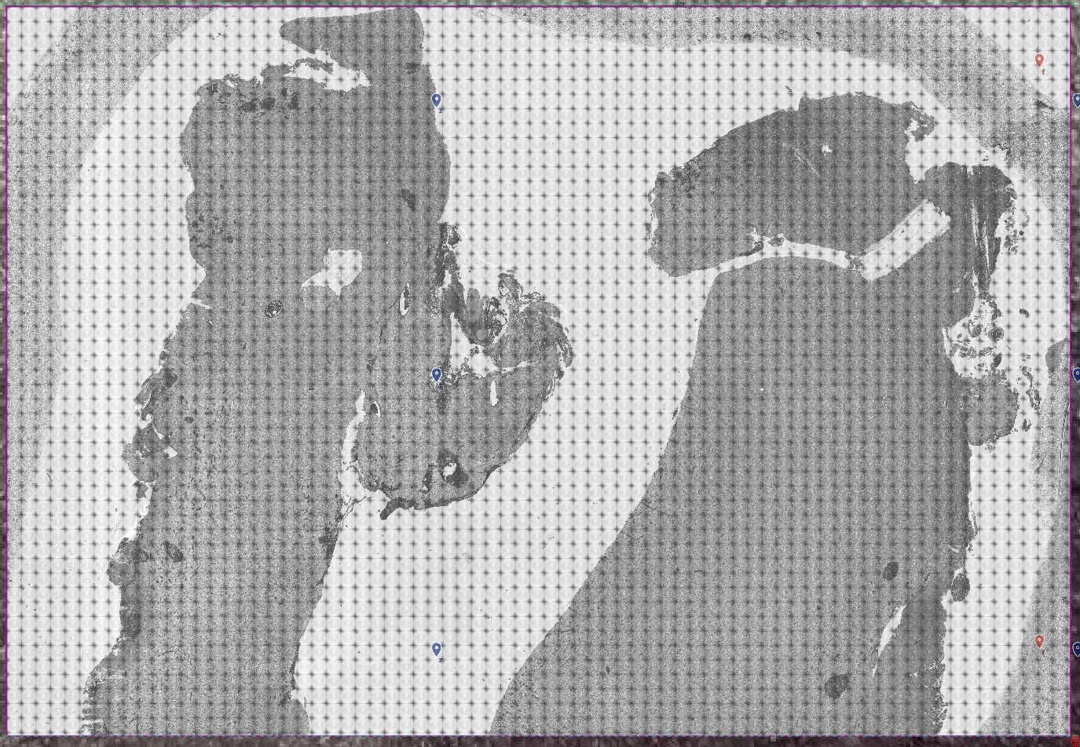
P82_1
P82_2
P82_3

Slide 16
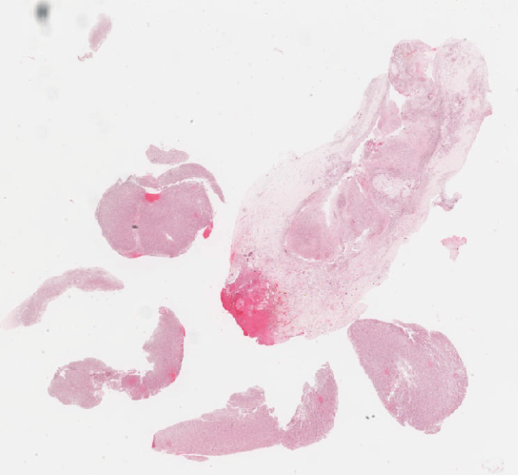
H&E https://www.virtualpathology.leeds.ac.uk/slides/browser/view.php?path=%2FResearch_5/LIMM/GliomaGenomics/SP/2021_10_29%2F501055.svs
CD68 https://www.virtualpathology.leeds.ac.uk/slides/browser/view.php?path=%2FResearch_5/LIMM/GliomaGenomics/SP/2021_12_08%2F507196.svs
CD45 https://www.virtualpathology.leeds.ac.uk/slides/browser/view.php?path=%2FResearch_5/LIMM/GliomaGenomics/SP/2021_12_08%2F507225.svs
Ki67 https://www.virtualpathology.leeds.ac.uk/slides/browser/view.php?path=%2FResearch_5/LIMM/GliomaGenomics/SP/2021_12_08%2F507204.svs
HiF1A https://www.virtualpathology.leeds.ac.uk/slides/browser/view.php?path=%2FResearch_5/LIMM/GliomaGenomics/SP/2021_12_08%2F507234.svs
Cells with hypoxia (Hif1a)
Cells that are proliferating (Ki67)
Immune cells (CD45 and CD68)

Slide 17
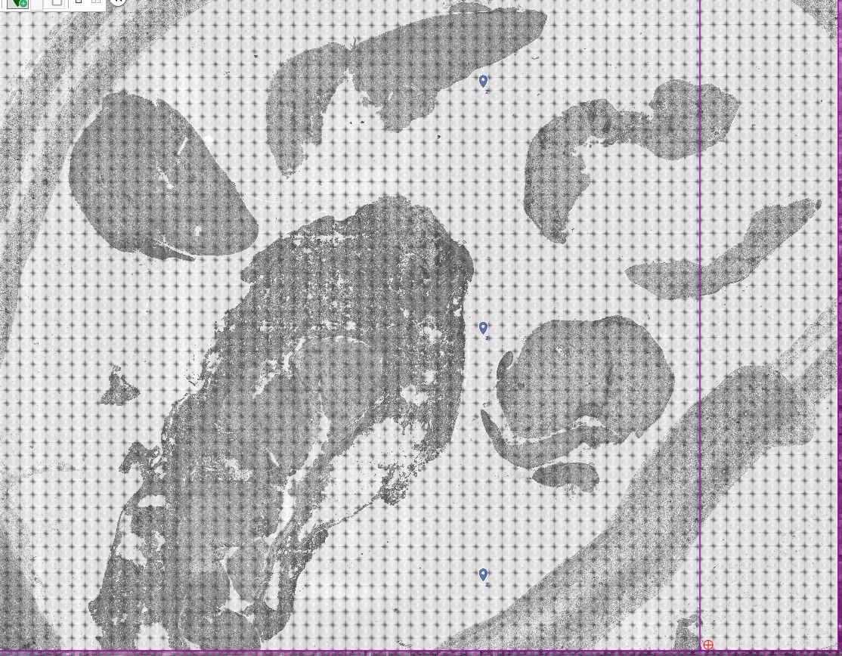
R82_3
R82_1
R82_2

Slide 18
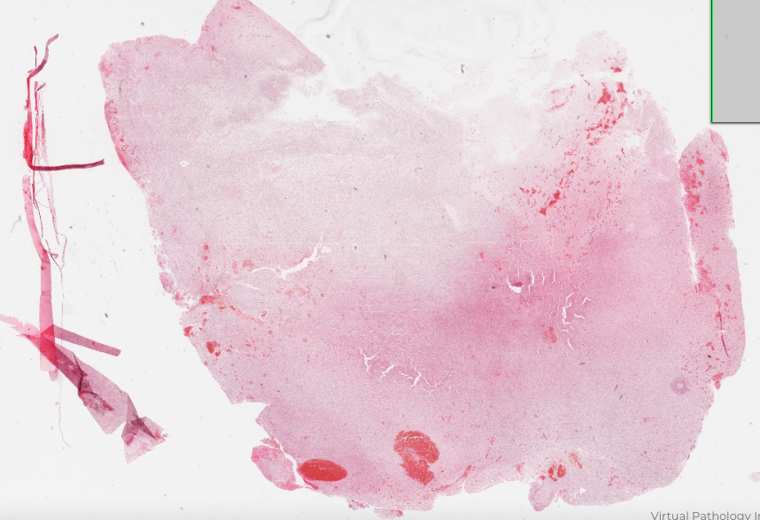
H&E https://www.virtualpathology.leeds.ac.uk/slides/browser/view.php?path=%2FResearch_5/LIMM/GliomaGenomics/SP/2021_10_29%2F501049.svs
CD68 https://www.virtualpathology.leeds.ac.uk/slides/browser/view.php?path=%2FResearch_5/LIMM/GliomaGenomics/SP/2021_12_08%2F507198.svs
CD45 https://www.virtualpathology.leeds.ac.uk/slides/browser/view.php?path=%2FResearch_5/LIMM/GliomaGenomics/SP/2021_12_08%2F507207.svs
Ki67 https://www.virtualpathology.leeds.ac.uk/slides/browser/view.php?path=%2FResearch_5/LIMM/GliomaGenomics/SP/2021_12_08%2F507203.svs
HiF1A https://www.virtualpathology.leeds.ac.uk/slides/browser/view.php?path=%2FResearch_5/LIMM/GliomaGenomics/SP/2021_12_08%2F507235.svs
84Prim003
84Prim002
Cells with hypoxia (Hif1a)
Cells that are proliferating (Ki67)
Immune cells (CD45 and CD68)
84Prim001

Slide 19
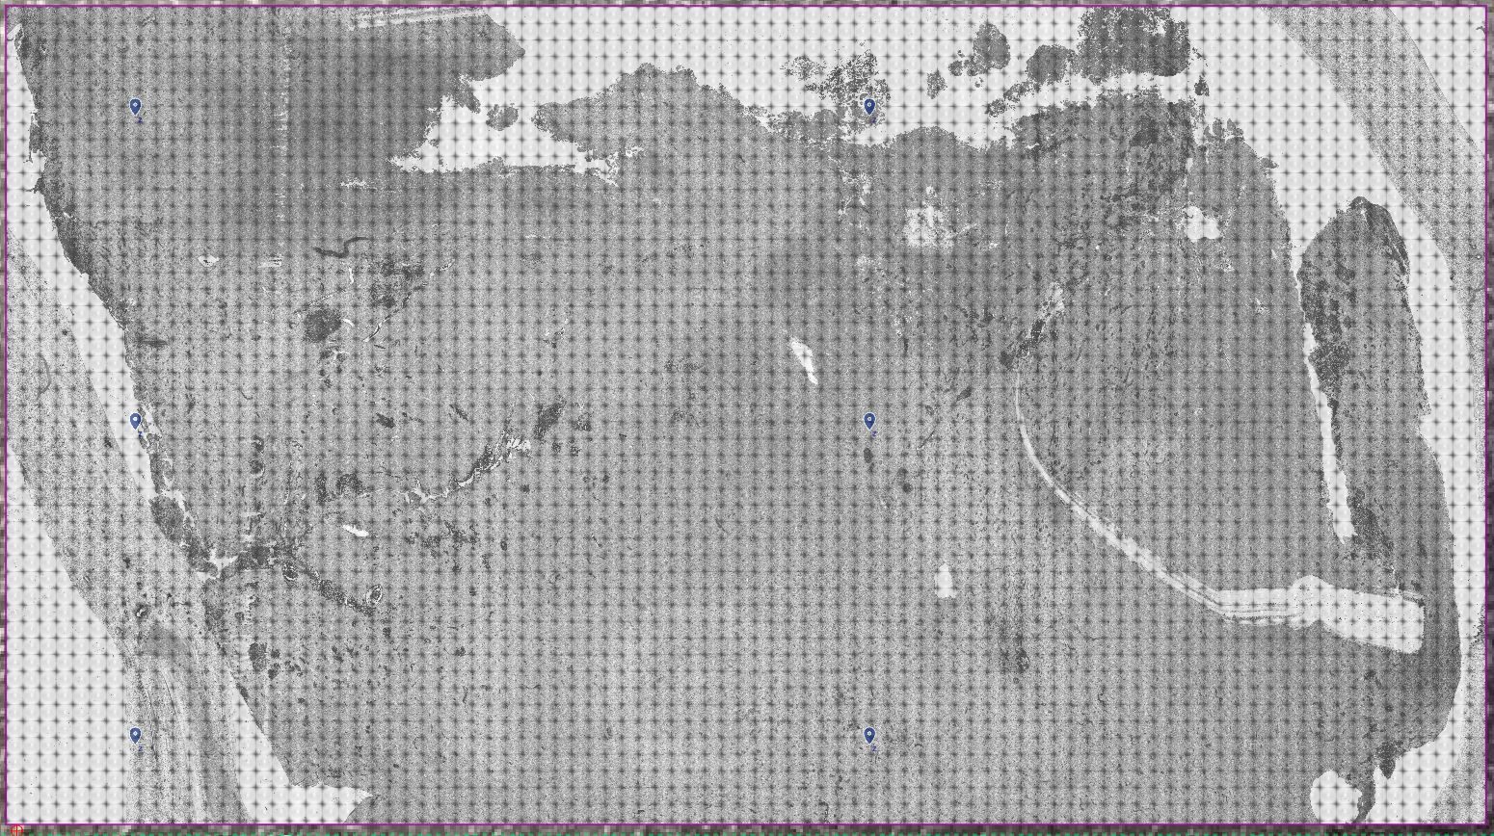
P84_3
P84_1
P84_2

Slide 20
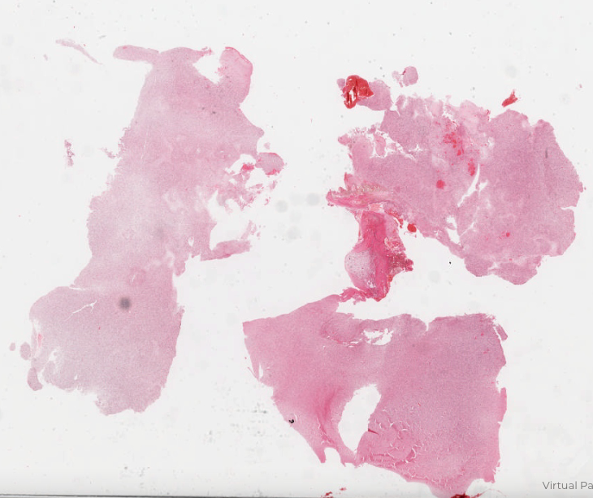
Cells with hypoxia (Hif1a)
Cells that are proliferating (Ki67)
Immune cells (CD45 and CD68)
84Rec002
84Rec001
84Rec003
H&E https://www.virtualpathology.leeds.ac.uk/slides/browser/view.php?path=%2FResearch_5/LIMM/GliomaGenomics/SP/2021_10_29%2F501053.svs
CD68 https://www.virtualpathology.leeds.ac.uk/slides/browser/view.php?path=%2FResearch_5/LIMM/GliomaGenomics/SP/2021_12_08%2F507202.svs
CD45 https://www.virtualpathology.leeds.ac.uk/slides/browser/view.php?path=%2FResearch_5/LIMM/GliomaGenomics/SP/2021_12_08%2F507208.svs
Ki67 https://www.virtualpathology.leeds.ac.uk/slides/browser/view.php?path=%2FResearch_5/LIMM/GliomaGenomics/SP/2021_12_08%2F507238.svs
HiF1A https://www.virtualpathology.leeds.ac.uk/slides/browser/view.php?path=%2FResearch_5/LIMM/GliomaGenomics/SP/2021_12_08%2F507236.svs

Slide 21
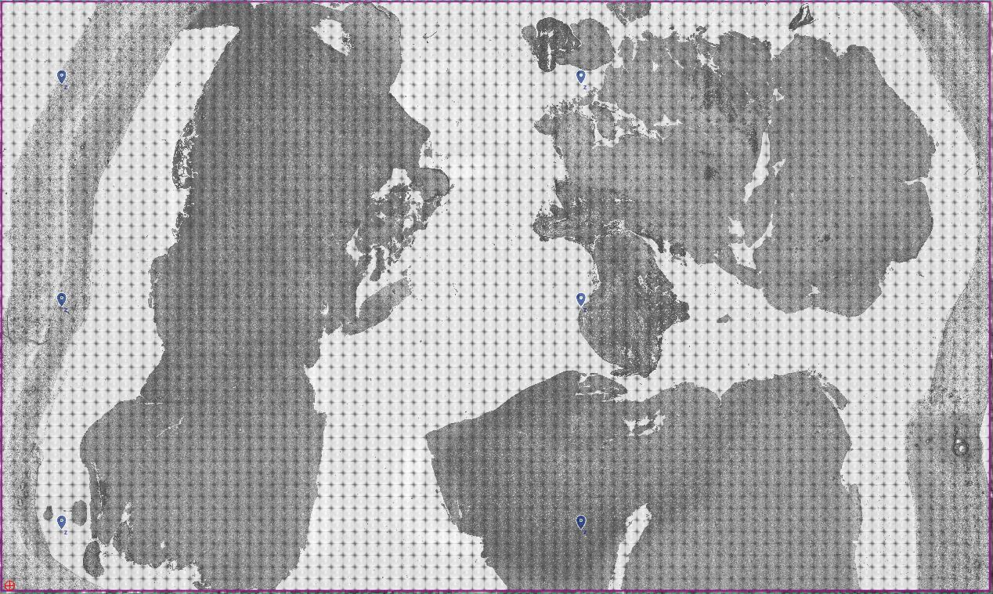
R84_2
R84_1
R84_3

